Slide 1


PSYCHOLOGY
Chapter 12 SOCIAL PSYCHOLOGY
PowerPoint Image Slideshow

Slide 2
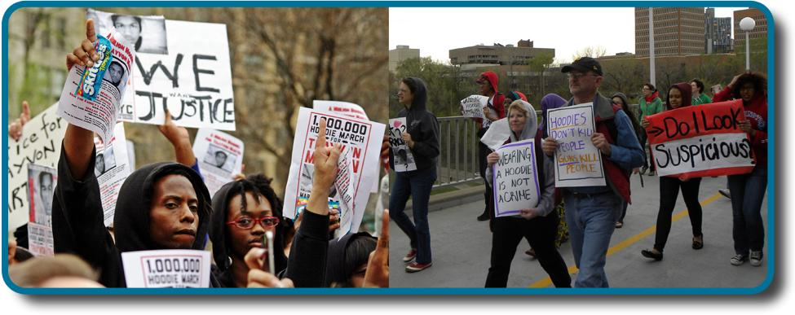
SOCIAL PSYCHOLOGY
How does the presence of other people influence the behavior of individuals, dyads, and groups?
Trayvon Martin, 17, was shot to death at the hands of George Zimmerman, a volunteer neighborhood watchman, in 2012. Was his death the result of self-defense or racial bias? That question drew hundreds of people to rally on each side of this heated debate.
Figure 12.1 (credit “signs”: modification of work by David Shankbone; credit “walk”: modification of work by "Fibonacci Blue"/Flickr)

Slide 3

WHAT IS SOCIAL PSYCHOLOGY?
Social psychology deals with all kinds of interactions between people, spanning a wide range of how we connect: from moments of confrontation to moments of working together and helping others.
Social psychologists believe that an individual’s thoughts, feelings, and behaviors are influenced by social situations.
Intrapersonal topics – emotions and attitudes, the self, and social cognition.
Interpersonal topics – helping behavior, aggression, prejudice and discrimination, attraction and close relationship, and group processes and intergroup relationships.
Figure 12.2 (credit: Sgt. Derec Pierson, U.S. Army)

Slide 4
SITUATIONAL & DISPOSITIONAL
INFLUENCES ON BEHAVIOR
Situationism – the view that our behavior and actions are determined by our immediate environment and surroundings.
Used by social psychologists.
Dispositionism – the view that our behavior is determined by internal factors (attribute of a person such as personality traits and temperament).
Favored in the U.S.
Used by personality psychologists.
Modern social psychologists often consider both the situation and individual.

Slide 5
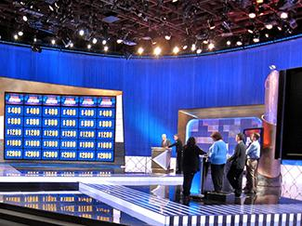
FUNDAMENTAL ATTRIBUTION ERROR
Fundamental attribution error – tendency to overemphasize internal factors as explanations/attributions for the behavior of other people and underestimate the power of the situation.
People tend to fail to recognize when a person’s behavior is due to situational variables.
Quizmaster Study:
Participants were randomly assigned to play the role of either the questioner or participant.
Questioners developed difficult questions to which they knew the answers.
Participants answered questions correctly 4/10 times.
Participants tended to disregard the influence of the situation and wrongly concluded that a questioner’s knowledge was greater than their own.
Figure 12.3 (credit: Steve Jurvetson)

Slide 6
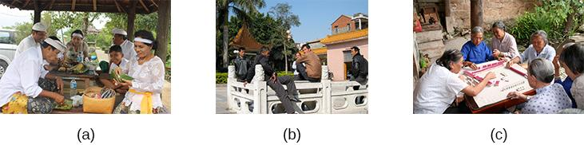
IS THE FUNDAMENTAL ATTRIBUTION ERROR
A UNIVERSAL PHENOMENON?
Research suggests that people from an individualistic culture have the greatest tendency to commit the fundamental attribution error.
People from collectivistic cultures, such as some Asian cultures, are more likely to emphasize relationships with others than to focus primarily on the individual. Focusing on others provides a broader perspective including both situation and cultural influences.
Activities such as (a) preparing a meal, (b) hanging out, and (c) playing a game engage people in a group.
Figure 12.4 (credit a: modification of work by Arian Zwegers; credit b: modification of work by "conbon33"/Flickr; credit c: modification of work by Anja Disseldorp)

Slide 7
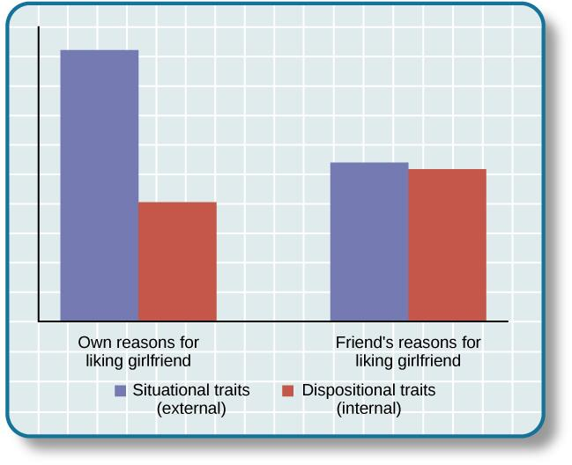
ACTOR-OBSERVER BIAS
Actor-observer bias – phenomenon of explaining other people’s behaviors are due to internal factors and our own behaviors are due to situational forces.
We often make the fundamental attribution error because we do not have enough information to make a situational explanation about the person’s behavior.
However, when we explain our own behaviors, we have more information available and are more likely to make situational explanations.
One study investigated reasons male participants gave for why they liked their girlfriend.
Actor-observer bias is evident when subjects explain their own reasons for liking a girlfriend (e.g., her personality) versus their impressions of others’ reasons for liking a girlfriend.
Figure 12.5

Slide 8
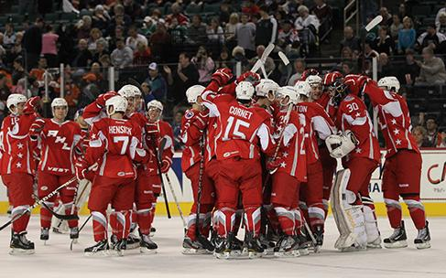
SELF-SERVING BIAS
Self-serving bias – tendency of an individual to take credit by making dispositional or internal attributions for positive outcomes but situational or external attributions for negative outcomes.
Protects self-esteem - allows people to feel good about their accomplishments.
Attribution – a belief about the cause of a result.
One model of attribution proposes three dimensions.
Locus of control – internal vs external.
Stability –extent to which the circumstances are changeable.
Controllability – extent to which the circumstances can be controlled.
When our team wins we make attributions such as it’s talented (internal), works hard (stable), and uses effective strategies (controllable).
When our team loses we might say the other team has more experienced players (external), the other team played at home (unstable), and the weather affected our teams performance (uncontrollable).
Figure 12.6 (Roesch & Amirkham, 1997). (credit: "TheAHL"/Flickr)

Slide 9
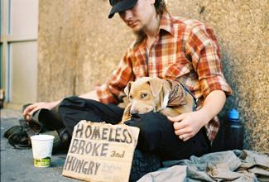
JUST WORLD HYPOTHESIS
A consequence of the tendency to provide dispositional explanations for behavior is victim blame.
Just-world hypothesis – belief that people get the outcomes they deserve.
Based on the belief that the world is a fair place and therefore good people experience positive outcomes, and bad people experience negative outcomes.
Allows people to feel that the world is predictable and we have some control over life outcomes.
People who hold just-world beliefs tend to blame the people in poverty for their circumstances, ignoring situational and cultural causes of poverty.
Figure 12.7 (credit: Adrian Miles)

Slide 10
SELF-PRESENTATION
SOCIAL ROLES
SOCIAL NORMS
SCRIPTS
ZIMBARDO

Slide 11
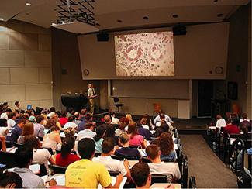
SOCIAL ROLES
Social role – a pattern of behavior that is expected of a person in a given setting or group.
E.g. being a student.
We each have several social roles.
Defined by culturally shared knowledge.
Behavior related to social roles varies across situations.
Being a student is just one of the many social roles you have.
Figure 12.8 (credit: “University of Michigan MSIS”/Flickr)

Slide 12
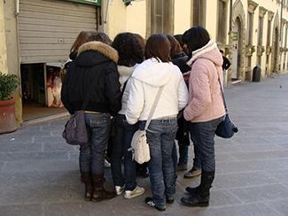
SOCIAL NORMS & SCRIPTS
Social norm – a group’s expectation of what is appropriate and acceptable behavior for its members.
How are we supposed to behave and think?
What are we expected to talk about?
What are we expected to wear?
Script – a person’s knowledge about the sequence of events expected in a specific setting.
How do you act when you walk into an elevator, on the first day of school, in a restaurant?
Scripts vary between cultures.
Important sources of information to guide behavior in situations.
Young people struggle to become independent at the same time they are desperately trying to fit in with their peers.
Figure 12.9 (credit: Monica Arellano-Ongpin)

Slide 13
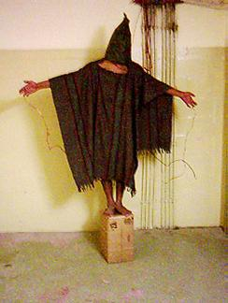
PHILIP ZIMBARDO
The Stanford Prison Experiment (1971)
Demonstrated the power of social roles, social norms, and scripts.
A mock prison was constructed and participants (male college students), were randomly assigned to play the role of prisoners or guards.
In a very short amount of time, the guards started to harass the prisoner in an increasingly sadistic manner.
Prisoners began to show signs of severe anxiety and hopelessness.
The two week study had to be ended after six days.
Social norms required guards to be authoritarian and prisoners to be submissive.
Scripts influenced the way guards degraded the prisoners by making them do push-ups and removing privacy.
Parallels abuse used by guards in Abu Ghraib prison.
Iraqi prisoners of war were abused by their American captors in Abu Ghraib prison, during the second Iraq war.
Figure 12.10 (credit: United States Department of Defense)

Slide 14
ATTITUDES AND PERSUASION
COGNITIVE DISSONANCE
PERSUASION

Slide 15
ATTITUDE
Attitude – our evaluation of a person, an idea, or an object.
Can be positive or negative.
Influenced by external forces and internal factors that we control.
3 components:
Affective component – feelings.
Behavioral component – the effect of the attitude on behavior.
Cognitive component – belief and knowledge.

Slide 16
COGNITIVE DISSONANCE
Leon Festinger’s Theory of Cognitive Dissonance
Cognitive dissonance – psychological discomfort arising from holding two or more inconsistent attitudes, behaviors, or cognitions.
Believing cigarettes are bad for your health, but smoking cigarettes anyway, can cause cognitive dissonance.
To reduce cognitive dissonance, individuals can:
Change their behavior - quitting smoking.
Change their belief through rationalization or denial - such as discounting the evidence that smoking is harmful.
Add a new cognition – “Smoking suppresses appetite so I don’t become overweight, which is good for my health”.
Later research found:
Only conflicting cognitions that threaten positive self-image cause dissonance.
Dissonance can also cause physiological arousal and activate brain regions involved in emotions and cognitive functioning.

Slide 17
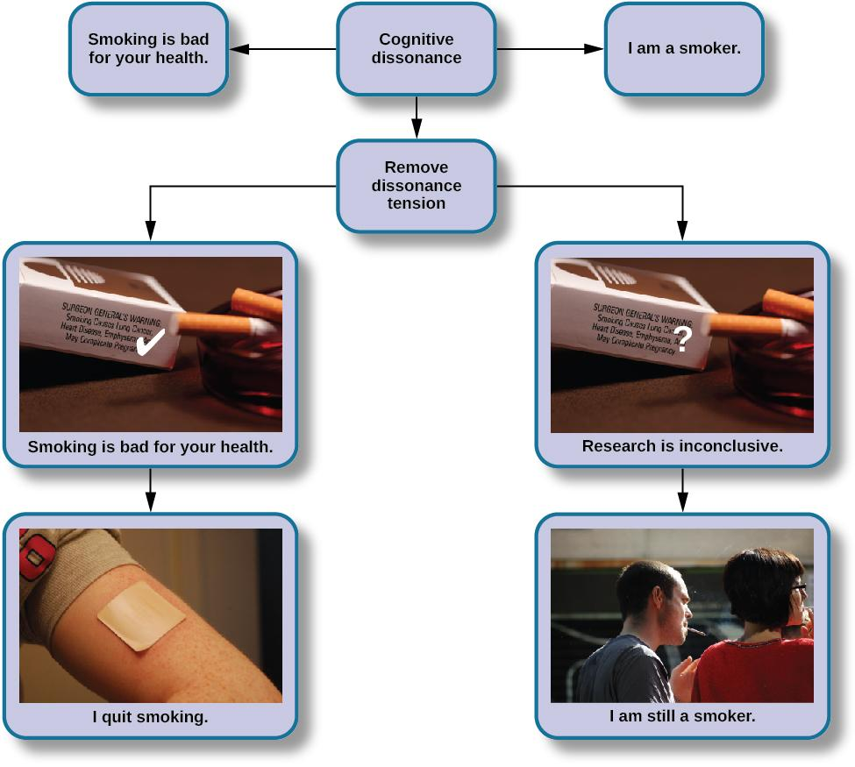
COGNITIVE DISSONANCE
Figure 12.11 (credit “cigarettes”: modification of work by CDC/Debora Cartagena; “patch”: modification of "RegBarc"/Wikimedia Commons; “smoking”: modification of work by Tim Parkinson)

Slide 18
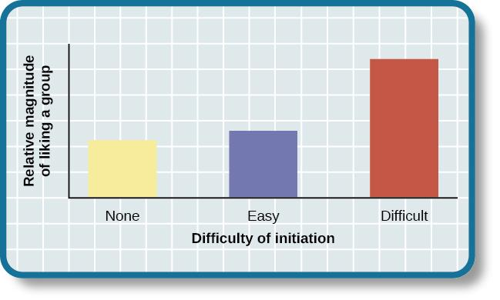
THE EFFECT OF INITIATION
Justification of effort has a distinct effect on a person liking a group.
A difficult initiation into a group influences us to like the group more.
Aronson and Mills Experiment (1959):
College students volunteered to join a group that would regularly to discuss the psychology of sex.
3 conditions – no initiation, easy initiation, difficult initiation.
Students in the difficult initiation condition liked the group more than students in other conditions due to the justification of effort.
Figure 12.13

Slide 19
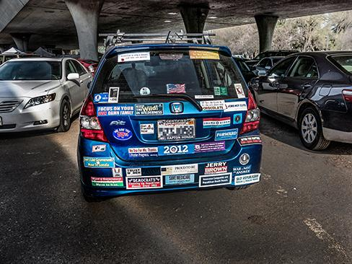
PERSUASION
Persuasion – process of changing our attitudes toward something based on some kind of communication.
How do people convince others to change their attitudes, beliefs, and behaviors?
We encounter attempts at persuasion attempts everywhere. Persuasion is not limited to formal advertising; we are confronted with it throughout our everyday world.
Figure 12.14 (credit: Robert Couse-Baker)

Slide 20
ELABORATION LIKELIHOOD MODEL
PETTY & CACIOPPO (1986)
Persuasion can take one of two paths, and the durability of the end result depends on the path.
Central Route
Logic driven.
Uses data and facts.
Direct route to persuasion focusing on the quality of information.
Works best when audience is analytical and willing to engage in processing of the information.
Peripheral Route
Indirect route.
Uses peripheral cues to associate positivity with the message.
Uses characteristics such as positive emotion or celebrity endorsement.
Results in less permanent attitude change.

Slide 21
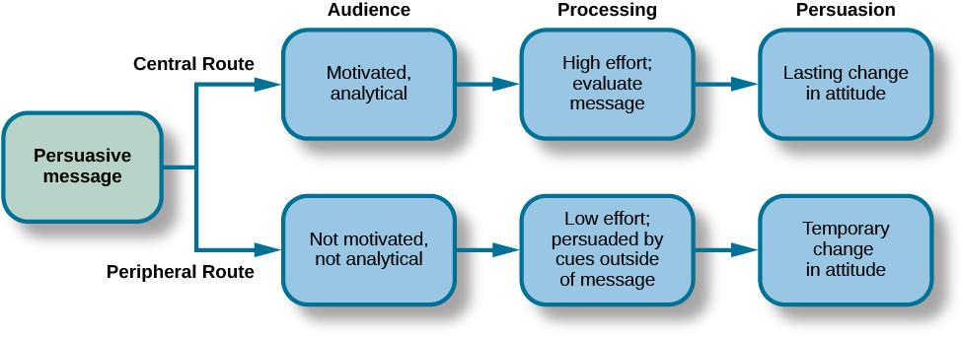
ELABORATION LIKELIHOOD MODEL
PETTY & CACIOPPO (1986)
Figure 12.15

Slide 22
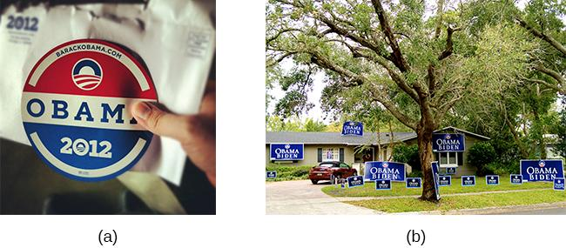
FOOT-IN-THE-DOOR TECHNIQUE
Foot-in-the-door technique – persuader gets a person to agree to a small favor, only to later request a larger favor.
Our past behavior often directs our future behavior (desire to maintain consistency.
With the foot-in-the-door technique, a small request such as
wearing a campaign button can turn into a large request, such as
putting campaigns signs in your yard.
Figure 12.16 (credit a: modification of work by Joe Crawford; credit b: modification of work by "shutterblog"/Flickr)

Slide 23
CONFORMITY, COMPLIANCE & OBEDIENCE
SOLOMON ASCH
STANLEY MILGRAM
GROUPTHINK
GROUP POLARIZATION

Slide 24
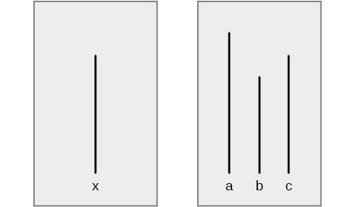
CONFORMITY
SOLOMON ASCH
Conformity – the change in a person’s behavior to go along with the group, even if he does not agree with the group.
Asch’s Experiment
These line segments illustrate the judgment task in Asch’s conformity study.
Which line on the right—a, b, or c—is the same length as line x on the left?
Figure 12.17

Slide 25
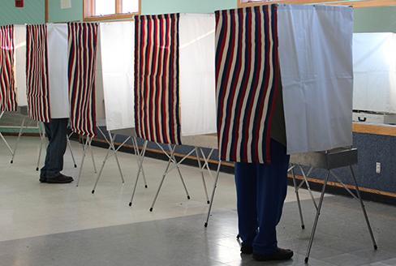
CONFORMITY
SOLOMON ASCH
Asch effect – the influence of the group majority on an individual’s judgement.
In Asch’s study there was one naive subject, the rest were confederates who purposely gave the wrong answer. 76% of participants conformed to group pressure at least once by also indicating the incorrect line.
What factors make a person more likely conform?
The size of the majority – the greater the majority, the more likely an individual will conform.
The presence of another dissenter – causes conformity rates to drop to near zero.
The public or private nature of the responses – public responses cause more conformity than private.
Voting for government officials in the United States is private to reduce the pressure of conformity.
Figure 12.18 (credit: Nicole Klauss)

Slide 26
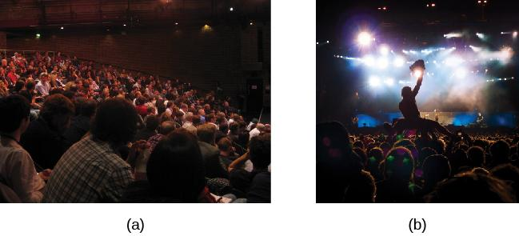
MOTIVATION TO CONFORM
Normative social influence – people conform to the group norm to fit in, to feel good, and to be accepted by the group.
Informational social influence – people conform because they believe the group is competent and has the correct information, particularly when the task or situation is ambiguous.
People in crowds tend to take cues from others and act accordingly.
An audience is listening to a lecture and people are relatively quiet, still, and attentive to the speaker on the stage.
An audience is at a rock concert where people are dancing, singing, and possibly engaging in activities like crowd surfing.
Figure 12.19 (credit a: modification of work by Matt Brown; credit b: modification of work by Christian Holmér)

Slide 27
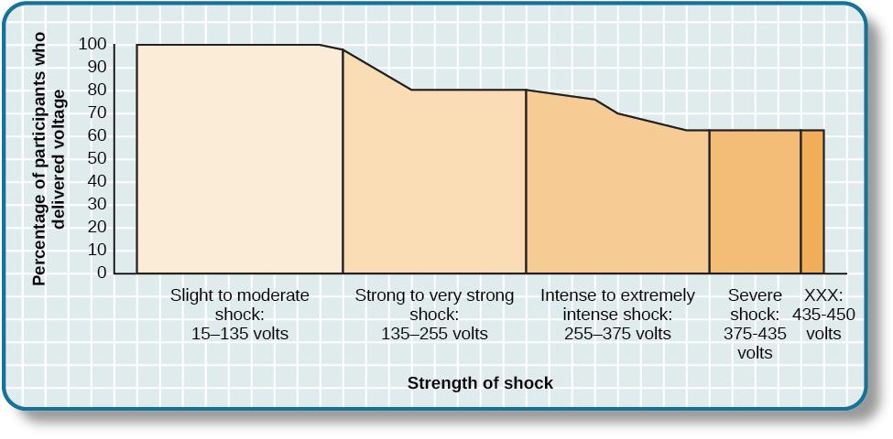
OBEDIENCE
STANLEY MILGRAM
Obedience – the change of an individual’s behavior to comply with a demand by an authority figure.
The Milgram experiment showed the surprising degree to which people obey authority.
Participants were told to shock “learners” (confederate) for giving a wrong answer to test items.
Participants believed they were giving the learners shocks, which increased all the way up to 450 volts.
Two out of three (65%) participants continued to administer shocks to an unresponsive learner.
Figure 12.20

Slide 28
GROUPTHINK & GROUP POLARIZATION
Groupthink
he modification of the opinions of members of a group to align with what they believe is the group consensus.
Groups often take action that individuals would not perform outside the group setting because groups make more extreme decisions that individuals do.
Members are less likely to express diverse opinions which can lead to faulty decision making.
Group Polarization
The strengthening of an original group attitude after the discussion of views within a group.
Does your opinion change if you find someone attractive, but you friends do not agree?

Slide 29
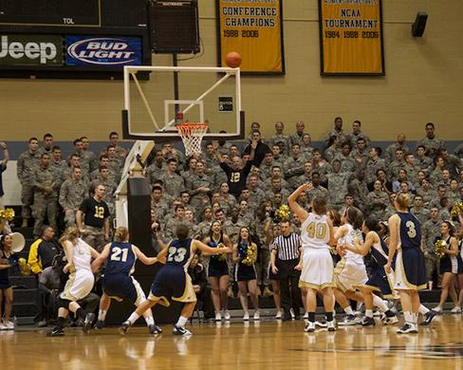
SOCIAL FACILITATION & SOCIAL LOAFING
Social Facilitation
Occurs when an individual performs better when an audience is watching than when the individual performs the behavior alone.
Usually occurs when people are performing a task for which they are skilled or an easy task.
However, when people are nervous or less skilled, an audience may hinder rather than help.
Social Loafing
The exertion of less effort by a person working together with a group.
Occurs when individual performance cannot be evaluated separately from the group.
Group performance declines on easy tasks.
However, when a task is difficult, people feel more motivated and believe that their group needs their input to do well on a challenging project.
The attention of the crowd can motivate a skilled athlete.
Figure 12.21 (credit: Tommy Gilligan/USMA)

Slide 30
PREJUDICE & DISCRIMINATION
UNDERSTANDING PREJUDICE & DISCRIMINATION
TYPES OF PREJUDICE & DISCRIMINATION
STEREOTYPES & SELF-FULFILLING PROPHECY
IN-GROUPS & OUT-GROUPS

Slide 31
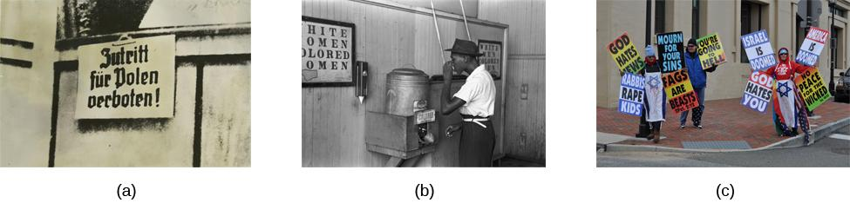
PREJUDICE & DISCRIMINATION
Prejudice and discrimination occur across the globe.
A 1939 sign in German-occupied Poland warns “No Entrance for Poles!”
An African-American male drinks from a designated “colored” water fountain in Oklahoma in 1939 during the era of racial segregation as a practice of discrimination.
A member of the Westboro Baptist Church, widely identified as a hate group, engages in discrimination based on religion and sexual orientation.
Figure 12.22 (credit b: modification of work by United States Farm Security Administration; credit c: modification of work by “JCWilmore”/Wikimedia Commons)

Slide 32
UNDERSTANDING PREJUDICE &
DISCRIMINATION
Prejudice – a negative attitude and feeling toward an individual based solely on one’s membership in a particular social group.
“I hate Yankees fans; they make me angry.”
Stereotype – a specific belief or assumption about individuals based solely on their membership in a group.
“Yankees fans are arrogant and obnoxious”.
Discrimination – a negative action toward an individual as a result of one’s membership in a particular group.
“I would never hire nor become friends with a person if I knew he or she were a Yankees fan.”
Why do prejudice and discrimination exist?
Social learning.
Conformity to social norms.

Slide 33
TYPES OF PREJUDICE & DISCRIMINATION
Racism
Prejudice and discrimination against an individual based on race.
Dual Attitudes Model:
Explicit – conscious and controllable.
Implicit – Unconscious and uncontrollable.
Most people no longer show extreme racial bias on measures of explicit attitudes but measures of implicit attitudes often provide evidence of mild to strong racial bias/prejudice. This can explain why modern forms of racism are hard to detect.
Ageism
Prejudice and discrimination toward individuals based solely on their age.
Typically against older adults.
Homophobia
Prejudice and discrimination of individuals based solely on their sexual orientation.
Often results in discrimination of individuals from social groups.
Widespread in U.S. society.

Slide 34
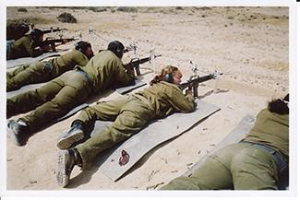
TYPES OF PREJUDICE & DISCRIMINATION
Sexism
Prejudice and discrimination toward individuals based on their sex.
Common examples include gender role expectations and expectations for how a gender group should behave.
Can exist on a societal level – employment and education opportunities.
Women now have many jobs previously closed to them, though they still face challenges in male-dominated occupations.
Figure 12.23 (credit: "Alex"/Flickr)

Slide 35
SELF-FULFILLING PROPHECY &
CONFIRMATION BIAS
Self-fulfilling Prophecy
An expectation held by a person that alters his or her behavior in a way that tends to make it true.
Stereotypes → expectations about stereotype → treat person according to our expectations → influences person to act according to stereotypic expectations → confirms our stereotypic beliefs.
Rosenthal and Jacobson (1968):
Disadvantaged students who had teachers that expected them to perform well had higher grades than disadvantaged students whose teachers expected them to do poorly.
Confirmation bias
Tendency to seek out information that supports our stereotypes and ignore information that is inconsistent with our stereotypes.

Slide 36
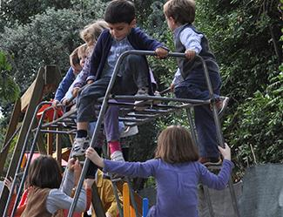
IN-GROUPS & OUT-GROUPS
In-groups – a group that we identify with or see ourselves as belonging to.
Out-groups – a group that we view as fundamentally different from us.
In-group bias – prejudice and discrimination because the out-group is perceived as different and is less preferred than our in-group.
We want to feel good and protect our in-groups.
Forces that promote reconciliation between groups:
The expression of empathy.
Acknowledgement of past suffering on both sides.
The halt of destructive behaviors.
Scapegoating – the act of blaming an out-group when the in-group experiences frustration or is blocked from obtaining a goal.
These children are very young, but they are already aware of their gender in-group and out-group.
Figure 12.24 (credit: modification of work by Simone Ramella)

Slide 37
AGGRESSION

Slide 38
AGGRESSION
Aggression – seeking to cause harm or pain to another person.
Hostile aggression – motivated by feelings of anger with intent to cause pain.
E.g., a bar fight.
Instrumental aggression – motivated by achieving a goal and does not necessarily involve intent to cause pain.
Typically displayed by women.
E.g., communication that impairs the social standing of another person.
Frustration Aggression Theory:
When humans are prevented from achieving an important goal, they become frustrated and aggressive.

Slide 39

EVOLUTIONARY THEORY OF AGGRESSION
Evolutionary theory - aggression serves an evolutionary function.
Men are more likely to show aggression - likely serves to display dominance over other males.
  To protect a mate.
  To perpetuate the male’s genes.
Human males and nonhuman male primates endeavor to gain and display dominance over other males, as demonstrated in the behavior of these monkeys.
Figure 12.25 (credit: “Arcadiuš”/Flickr)

Slide 40

BULLYING
Bullying – repeated negative treatment of another person over time.
The attempt to inflict harm, injury, or humiliation.
Can include physical or verbal attacks.
Can also be psychological.
Gender differences:
Boys – tend to engage in direct, physical aggression.
Girls – tend to engage in indirect, social forms of aggression (e.g., spreading rumors, ignoring, or socially isolating others).
Effects on the Victim:
Decreased mental health including anxiety and depression.
May underperform in school work.
Cyberbullying – repeated behavior that is intended to cause psychological or emotional harm to another person.
More common in girls (usually in those that have been victims of cyberbullying themselves).
Figure 12.26 (credit: Steven Depolo)

Slide 41
THE BYSTANDER EFFECT
Kitty Genovese (1964)
Attacked and killed with a knife outside her apartment building.
Residents in the apartment building heard her scream for help numerous times but did nothing.
Latane & Darley
Bystander Effect – phenomenon in which a witness/bystander does not volunteer to help a victim or person in distress.
Based on the social situation, not personality variables.
Diffusion of responsibility – tendency for no one in a group to help because the responsibility to help is spread throughout the group.

Slide 42
PROSOCIAL BEHAVIOR
PROSOCIAL BEHAVIOR & ALTRUISM
FORMING RELATIONSHIPS
ATTRACTION
STERNBERG’S TRIANGULAR THEORY OF LOVE
SOCIAL-EXCHANGE THEORY

Slide 43
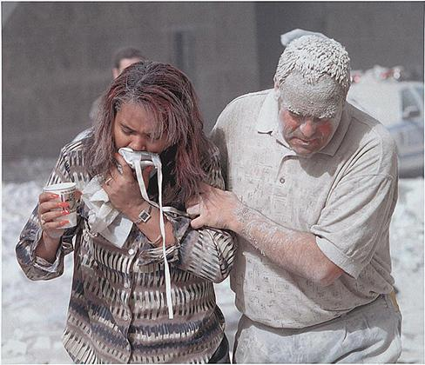
PROSOCIAL BEHAVIOR AND ALTRUISM
Prosocial behavior – voluntary behavior with the intent to help other people.
Altruism – people’s desire to help others even if the costs outweigh the benefits of helping.
The events of 9/11 unleashed an enormous show of altruism and heroism on the parts of first responders and many ordinary people.
Theories on the Motivation to Help
Empathy:
Empathy is the capacity to understand another person’s perspective, to feel what he/she feels.
Emphatic people make emotional connections with others and feel compelled to help.
Altruism is a form of selfless helping (not motivated by benefits).
Feeling good after helping is a consequence, not a cause.
Helping is self-serving because our egos are involved, and we receive benefits.
Figure 12.27 (credit: Don Halasy)

Slide 44
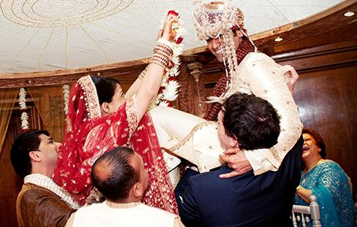
FORMING RELATIONSHIPS
What influences who we become friends with and form romantic relationships with?
Proximity – the people with whom you have the most contact.
Similarity – people who are similar to us in background, attitudes, and lifestyle.
  Homophily – the tendency for people to form social networks with others who are similar.
Important components of relationships:
Reciprocity – the give and take in relationships. We contribute to relationships, but expect to receive benefits in return.
Self-disclosure – the sharing of personal information.
  Leads to more intimate connections.
Many couples share a cultural background.
Figure 12.28 (credit: modification of work by Shiraz Chanawala)

Slide 45
ATTRACTION
What features of a person do we find attractive?
Universally Attractive Features
Women:
Physical – large eyes, high cheekbones, a narrow jaw line, a slender build, and a lower waist-to-hip ration.
Social traits – warmth, affection, and social skills.
Men:
Physical - tall, having broad shoulders, and a narrow waist.
Social traits – achievement, leadership qualities, and job skills.
Matching Hypothesis – people tend to pick someone they view as their equal in physical attractiveness and social desirability.

Slide 46
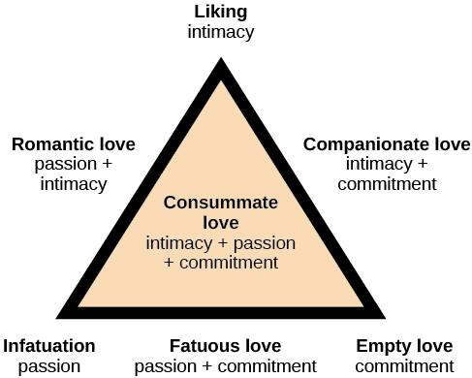
STERNBERG’S TRIANGULAR THEORY OF
LOVE
Seven types of love can be described from combinations of three components:
Intimacy – sharing of details and intimate thoughts and emotions.
Passion – physical attraction.
Commitment – standing by the person.
Figure 12.29 (credit: modification of work by “Lnesa”/Wikimedia Commons)

Slide 47
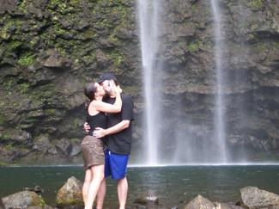
STERNBERG’S TRAINGULAR THEORY OF
LOVE
According to Sternberg, consummate love describes a healthy relationship containing intimacy, passion, and commitment.
Figure 12.30 (credit: Kerry Ceszyk)

Slide 48
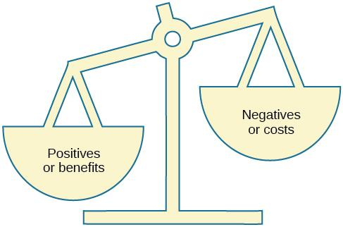
SOCIAL EXCHANGE THEORY
What determines whether we are satisfied with and stay in a relationship?
Social exchange theory – Acting like naïve economists, people may keep track of the costs and benefits of forming and maintaining a relationship.
Typically, only those relationships in which the benefits outweigh the costs will be maintained.
Figure 12.31

